Slide 1

Introduction to Machine Learning with H2O
Jo-fai (Joe) Chow
Data Scientist
joe@h2o.ai
@matlabulous
Data Science Milan
Politecnico di Milano
10th October, 2016

Slide 2
About Me: Civil Engineer → Data Scientist
2005 - 2015
Water Engineer
Consultant for Utilities
Industrial PhD
Water Engineering + Machine Learning
Discovered H2O in 2014!
2015 - Present
Data Scientist
Virgin Media (UK)
Domino Data Lab (US)
H2O.ai (US)
Why? Long story – see bit.ly/joe_h2o_talk2

Slide 3
Agenda
First Talk (25 mins)
About H2O.ai
Demo
A Simple Classification Task
H2O’s Web Interface
Why H2O?
Our Community
Our Customers
What’s Next?
New H2O Features
Second Talk (25 mins)
H2O for IoT
Predictive Maintenance
Anomaly Detection
H2O’s R Interface
Third Talk (25 mins)
Deep Water
Demo
H2O + mxnet on GPU
H2O’s Python Interface

Slide 4
About H2O.ai

Slide 5
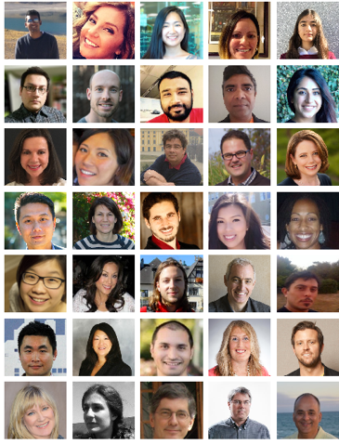
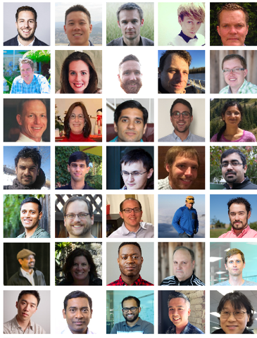







About H2O.ai
H2O.ai, the Company
Team: 80 (70 shown)
Founded in 2012
HQ: Mountain View, California
H2O, the Platform
Open Source (Apache 2.0)
Algorithms written in Java
Fast, distributed and scalable
Multiple interfaces to suit different users
Web, R, Python, Java, Scala, REST/JSON
Works with desktop/laptop, cloud, Spark and Hadoop
Joe

Slide 6


Scientific Advisory Council

Slide 7
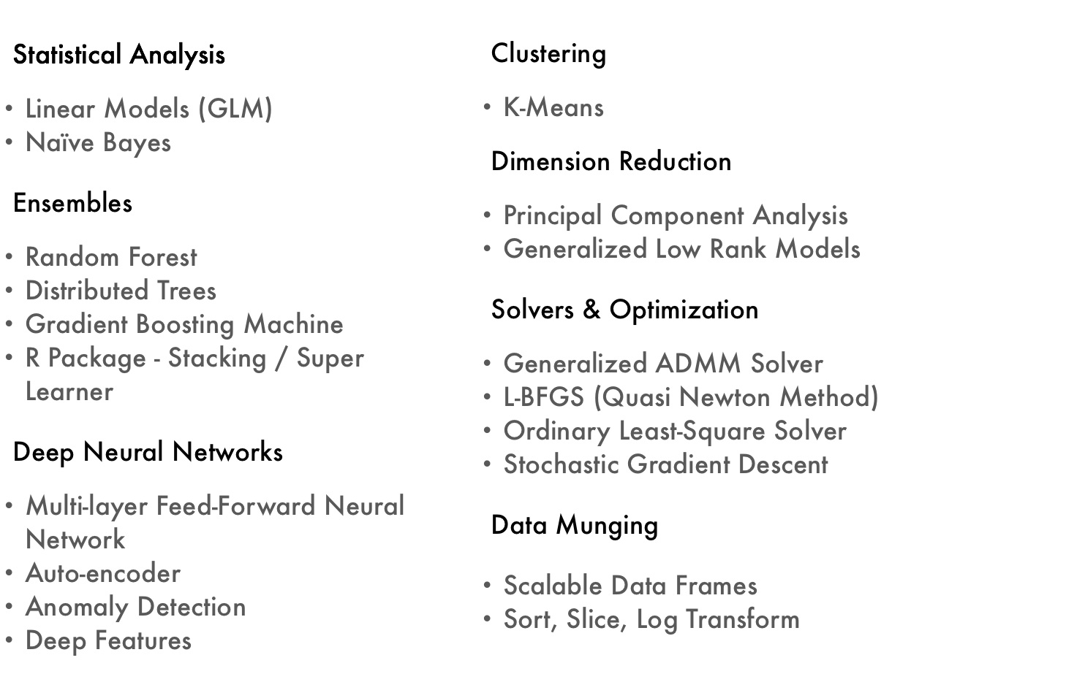
Current Algorithm Overview
Joe’s Strata Hadoop
London Talk
bit.ly/joe_h2o_talk4
Today’s Demos
Joe’s LondonR Talk
bit.ly/joe_h2o_talk3

Slide 8
H2O Overview
8

Slide 9
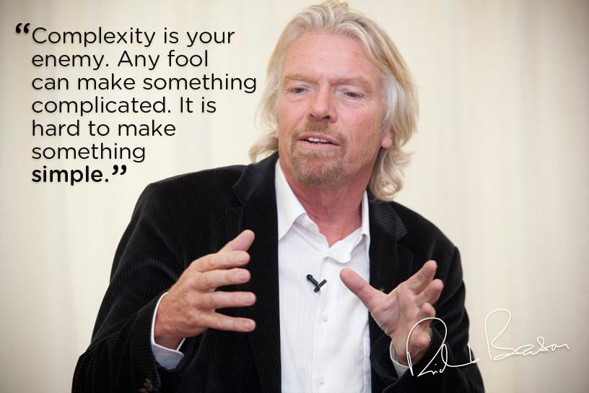
H2O’s Mission
Making Machine Learning Accessible to Everyone
Photo credit: Virgin Media

Slide 10
H2O Web Interface Demo

Slide 11
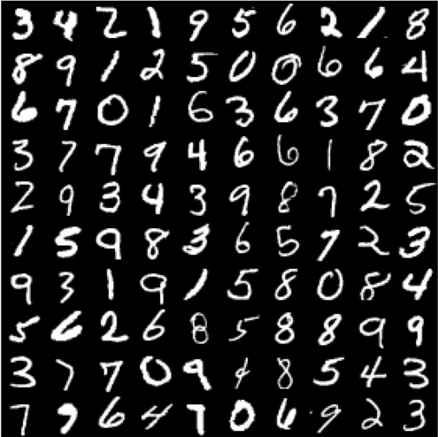
A Typical Machine Learning Task
Demo
Dataset – MNIST
LeCun et al. (1999)
Hand-written Digits
Import & Explore Data
Build & Evaluate Models
Make Predictions
Photo credit: http://www.opendeep.org/v0.0.5/docs/tutorial-classifying-handwritten-mnist-images

Slide 12
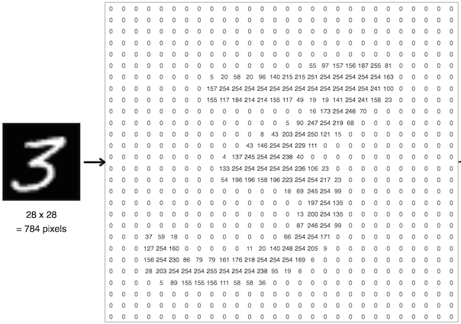
MNIST Hand-Written Digits
784 Inputs
28 x 28 = 784 pixels
1 Output
0, 1, 2, 3, 4, 5, 6, 7, 8 or 9
Classification
Files
Train (60k Records)
Test (10k)
Links
https://s3.amazonaws.com/h2o-public-test-data/bigdata/laptop/mnist/train.csv.gz
https://s3.amazonaws.com/h2o-public-test-data/bigdata/laptop/mnist/test.csv.gz
Photo credit: https://ml4a.github.io/ml4a/neural_networks/

Slide 13
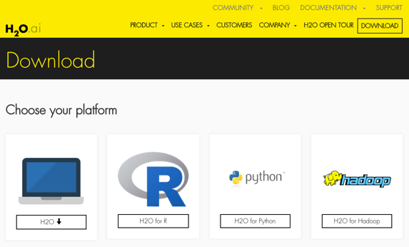
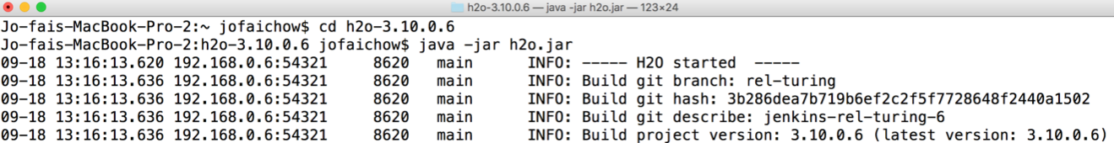
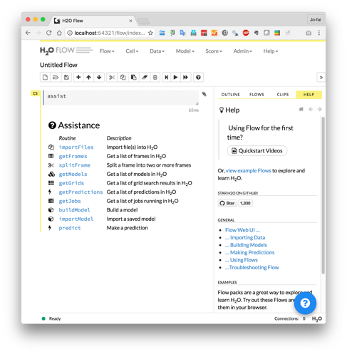
H2O Flow (Web Interface) Demo
Download and unzip jar from www.h2o.ai
In terminal:
java -jar h2o.jar
Web browser:
localhost:54321

Slide 14
H2O Live Demo

Slide 15
More H2O Flow Examples

Slide 16
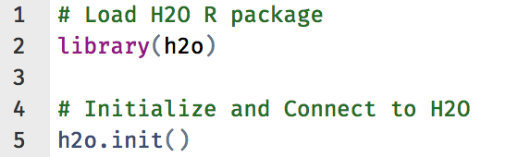
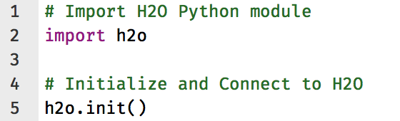
Other H2O Interfaces
Key Resources
R
Python
docs.h2o.ai

Slide 17
More Advanced Topics
Advanced Features
Hyperparameters Tuning
Model Stacking
Saving/Loading Models
Export Plain Old Java Object (POJO)
Key Resources
docs.h2o.ai
Joe’s Previous H2O Talks
bit.ly/joe_h2o_talk3
bit.ly/h2o_budapest_1
bit.ly/h2o_paris_1

Slide 18
Why H2O?

Slide 19


Slide 20
H2O Usage in Italy
www.h2o.ai/community

Slide 21
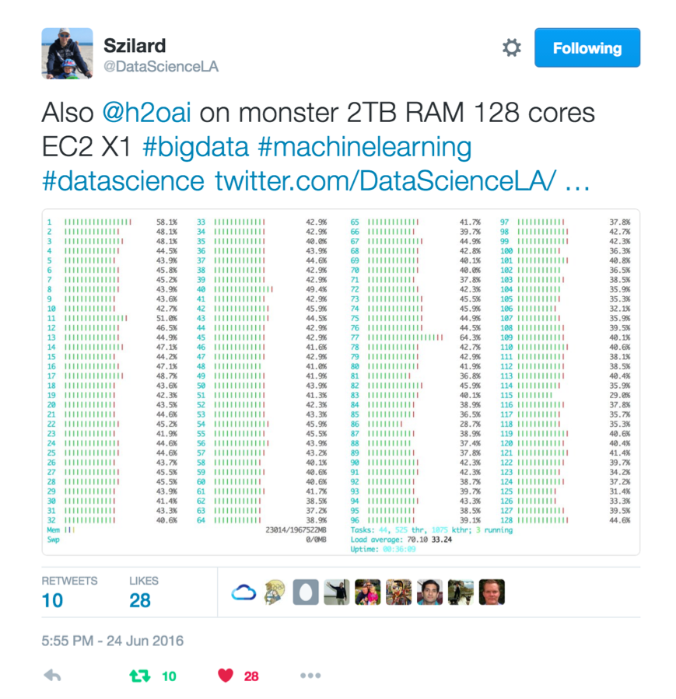
Szilard Pafka – ‎Chief Data Scientist at Epoch
Sziland’s talks / blog posts about H2O:
ML Benchmark
Intro to ML with H2O
H2O Scoring
Tweets

Slide 22

Szilard Pafka – Why H2O?
Szilard’s Summary Slide

Slide 23
H2O for Kaggle

Slide 24
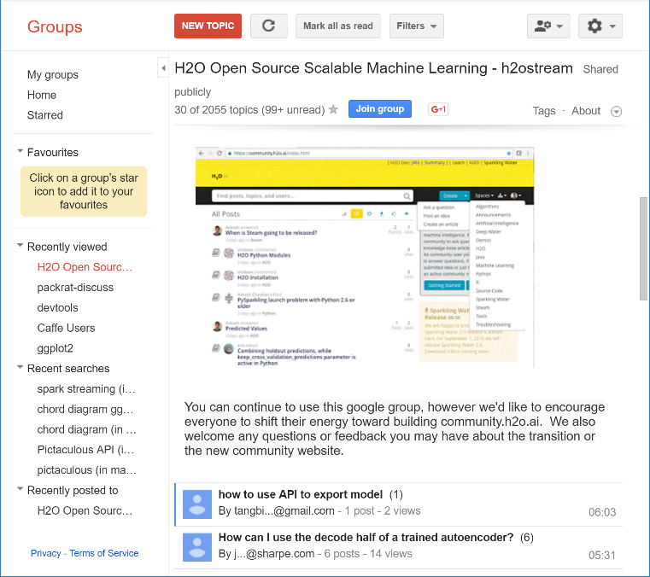
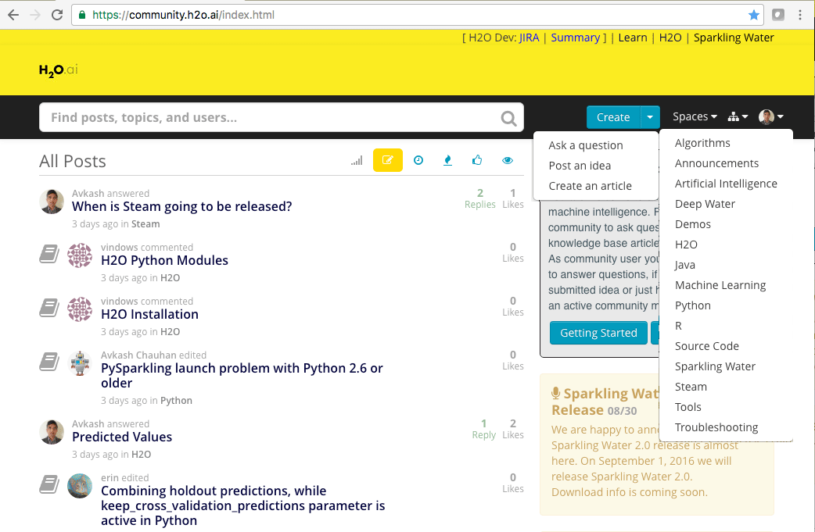
H2O Community Support
Please try
community.h2o.ai
Google forum – h2osteam

Slide 25
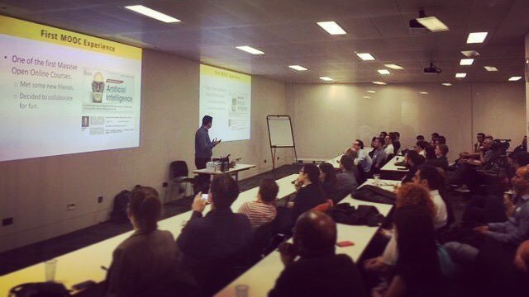
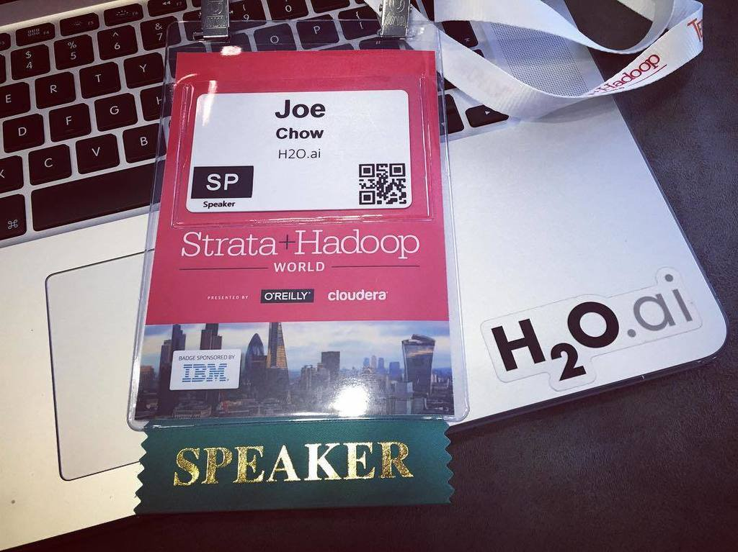
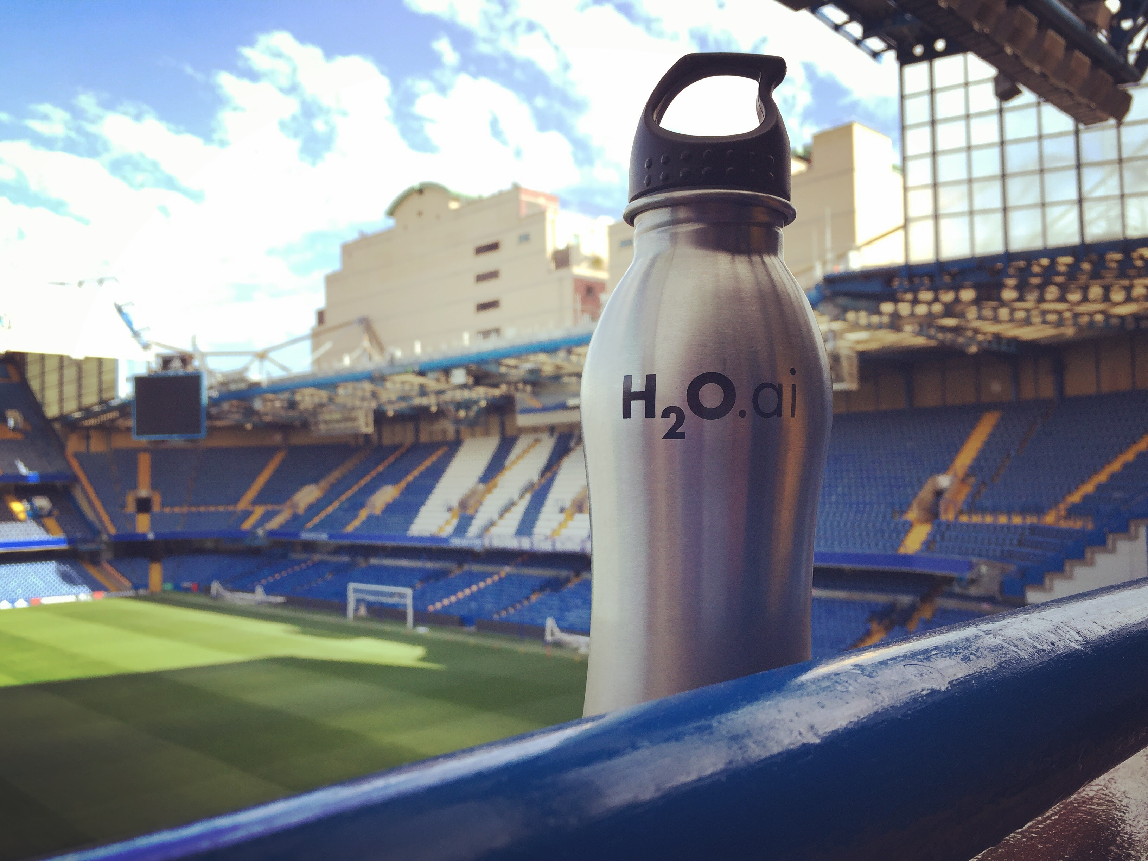

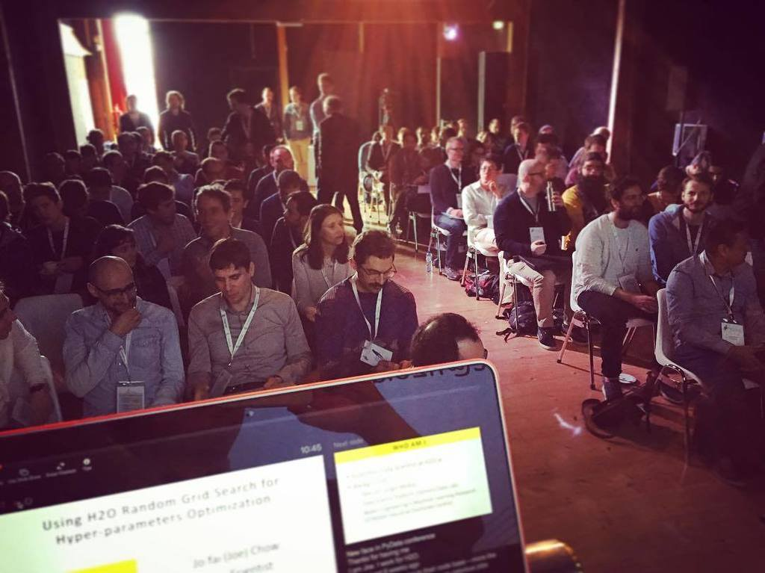
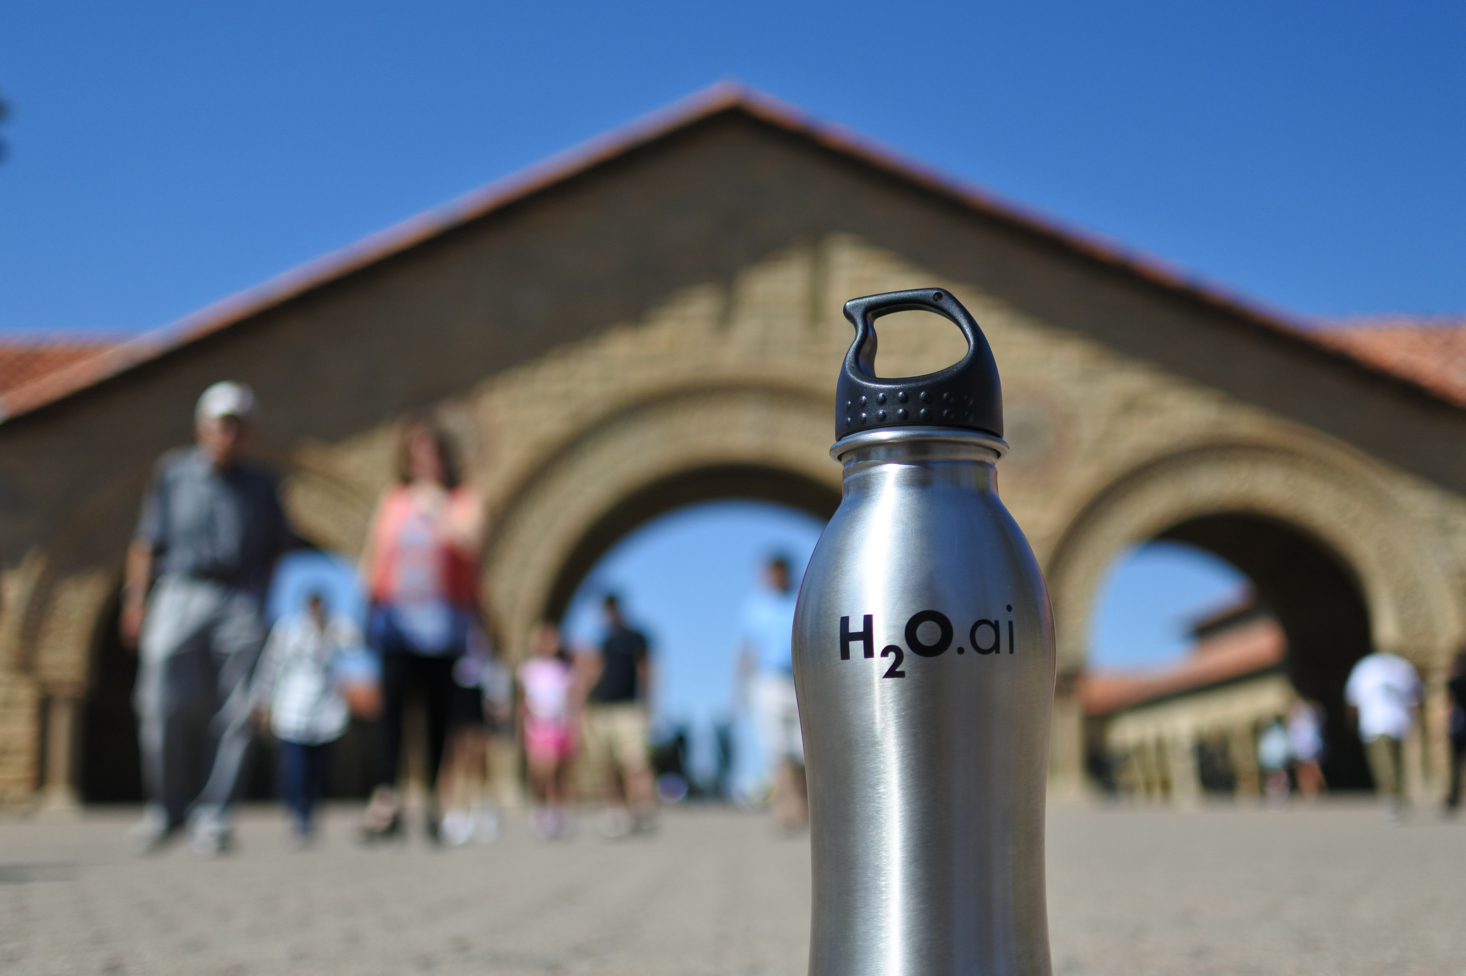
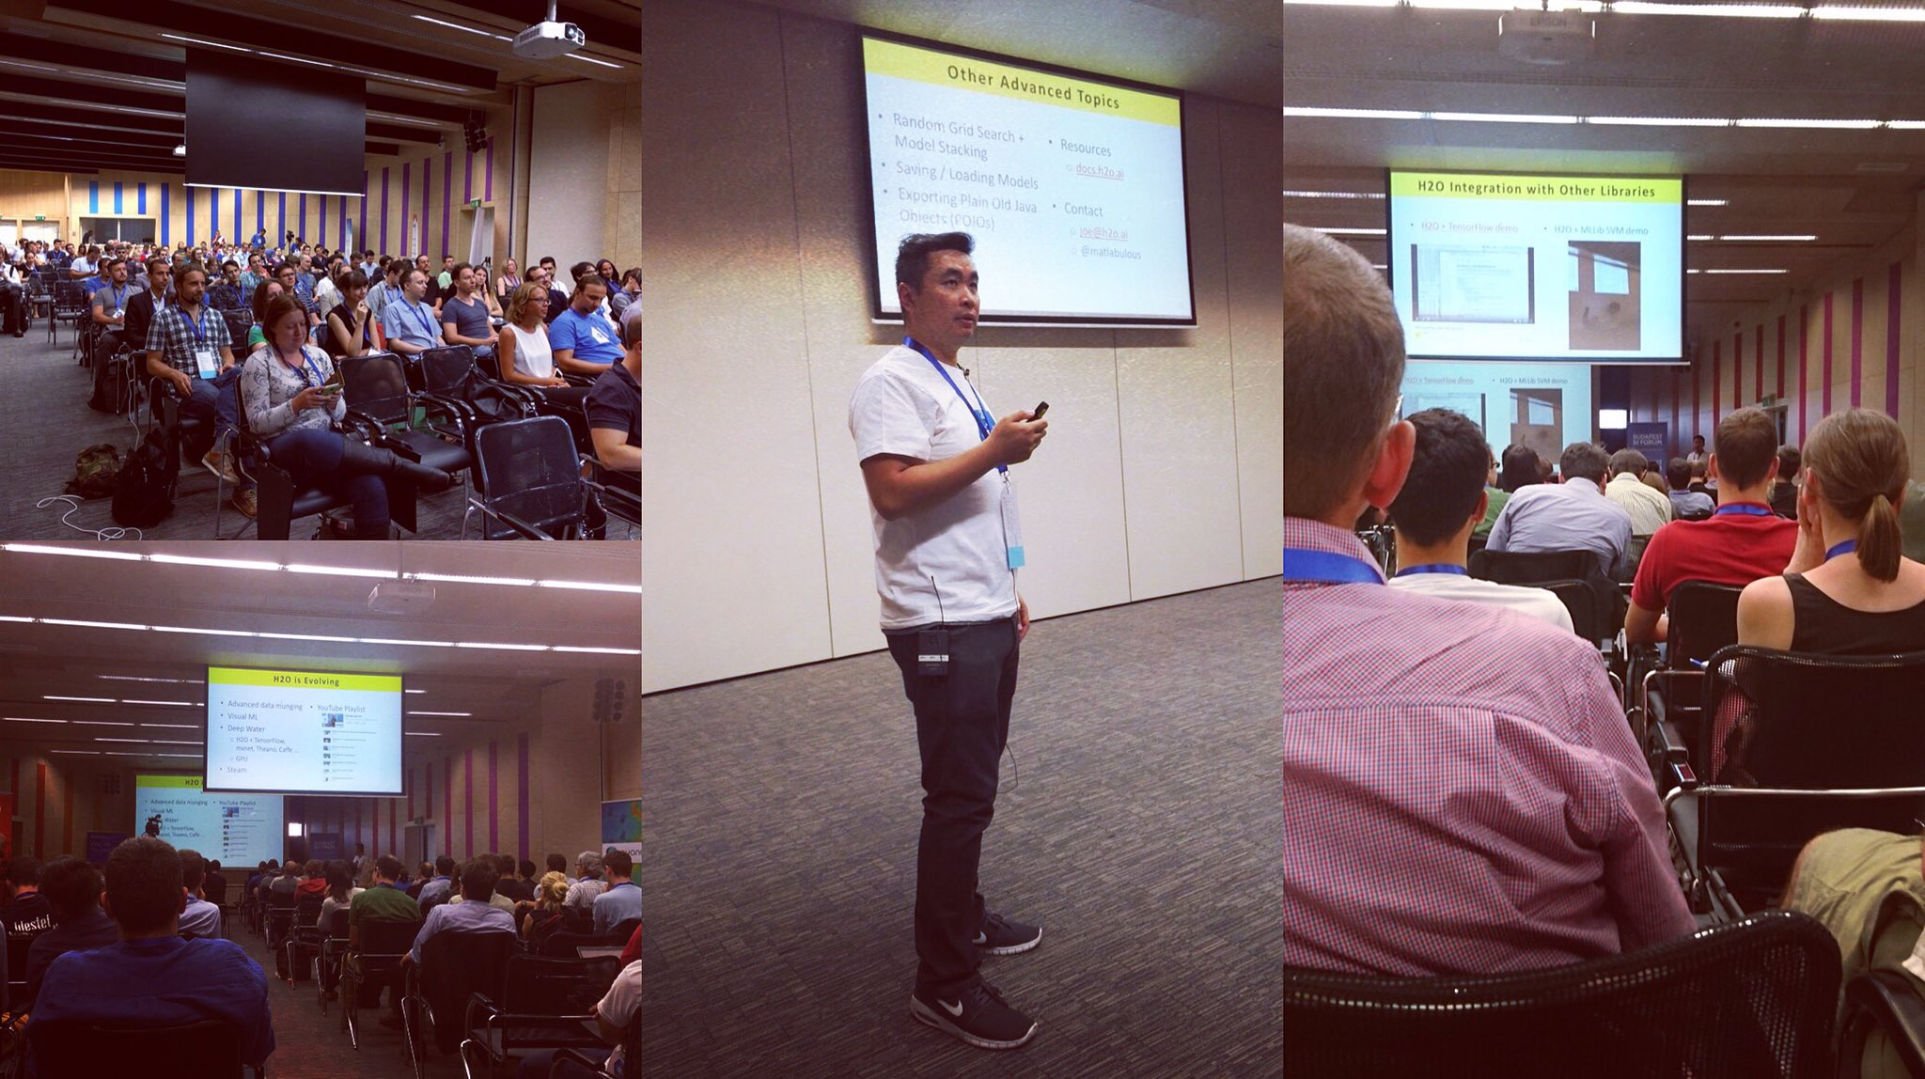
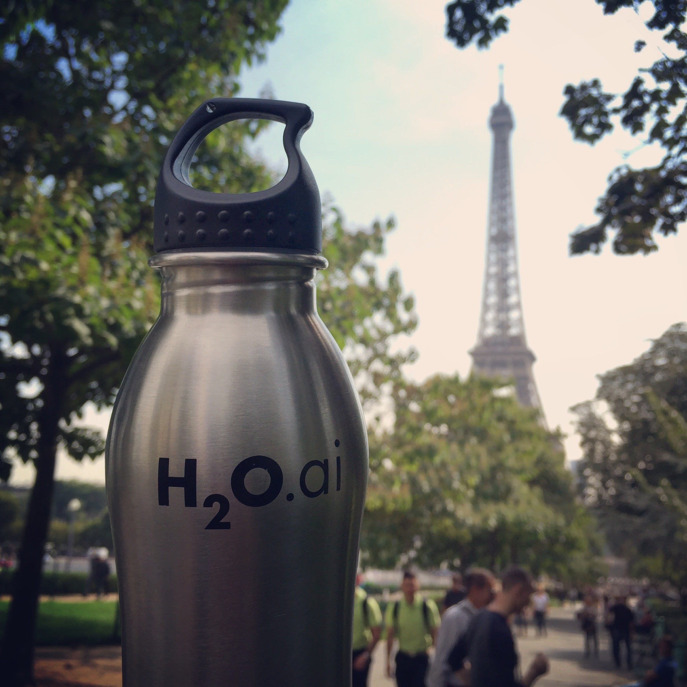
#AroundTheWorldWithH2Oai
London Kaggle Meetup
Strata Hadoop
London
Chelsea FC
Big Data London
PyData
Amsterdam
useR! 2016
Stanford
satRdays
Budapest
Paris ML Meetup

Slide 26


Slide 27
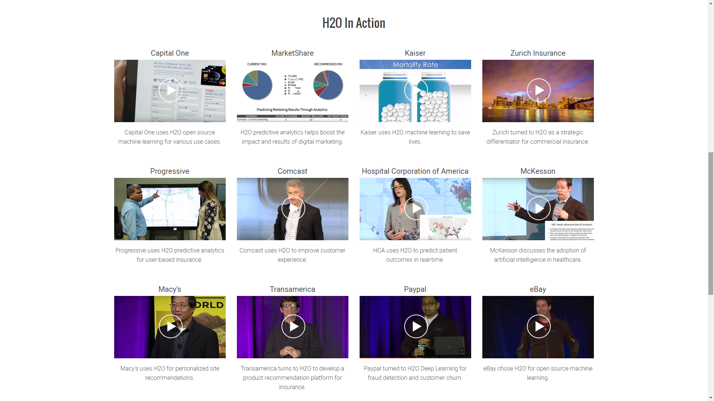
www.h2o.ai/customers

Slide 28
What’s Next?

Slide 29
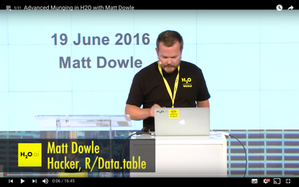
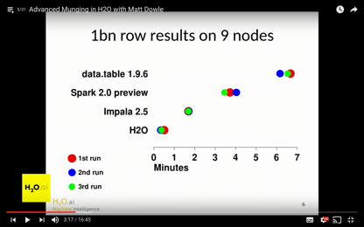
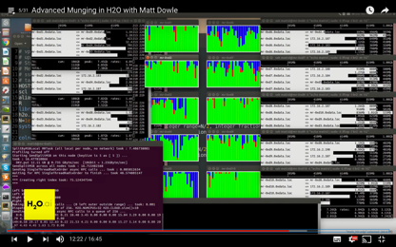
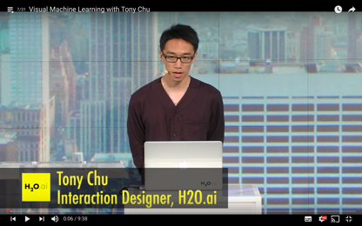
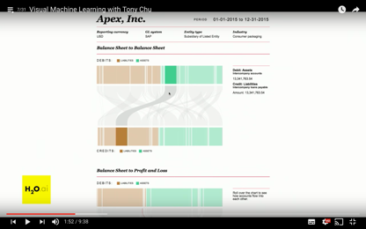
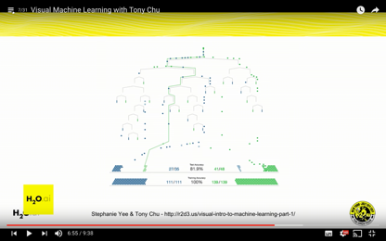
H2O is Evolving
H2O Open Tour NYC YouTube Playlist
Advanced data munging
Visual ML
Deep Water (3rd talk)
Sparkling Water
PySparkling & RSparkling
Steam
Next time?

Slide 30
H2O’s Mission
Making Machine Learning Accessible to Everyone
Photo credit: Virgin Media

Slide 31
End of First Talk – Thanks!
Data Science Milan
Gianmario Spacagna
Politecnico di Milano
Resources
bit.ly/h2o_milan_1
www.h2o.ai
docs.h2o.ai
Contact
joe@h2o.ai
@matlabulous
github.com/woobe

Slide 32
Extra Slides
(H2O Flow Demo Screenshots – just in case)

Slide 33
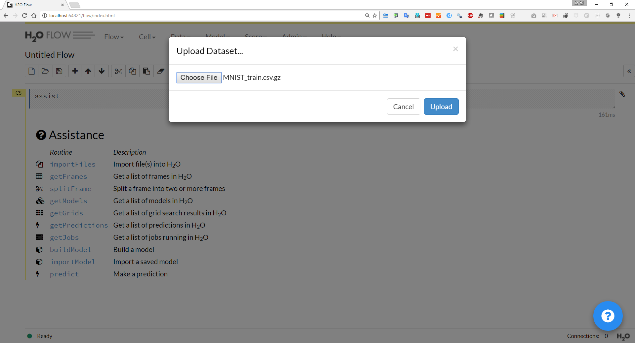
Upload the file without decompressing it first

Slide 34
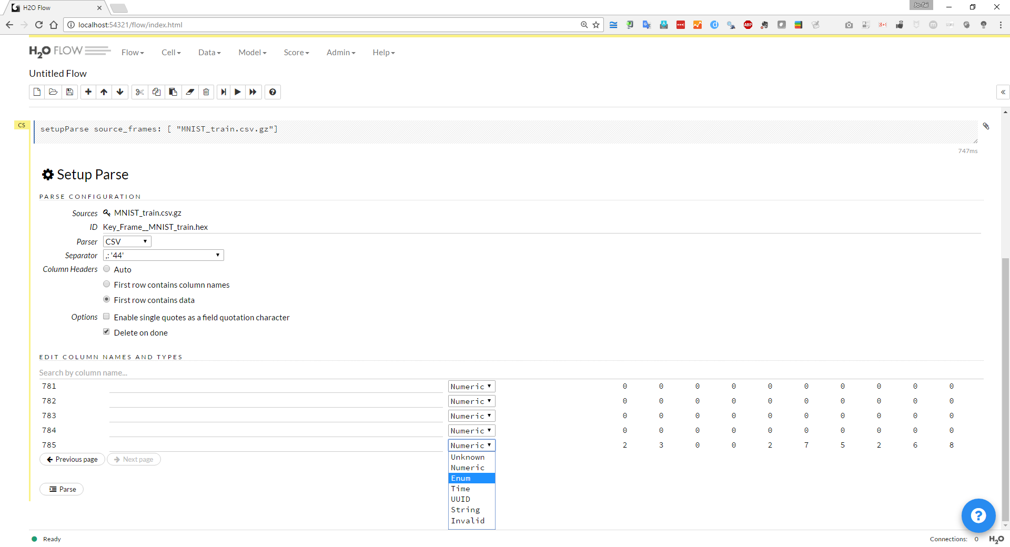
Change the data type of “label” from “Numeric” to “Enum” (categorical)

Slide 35
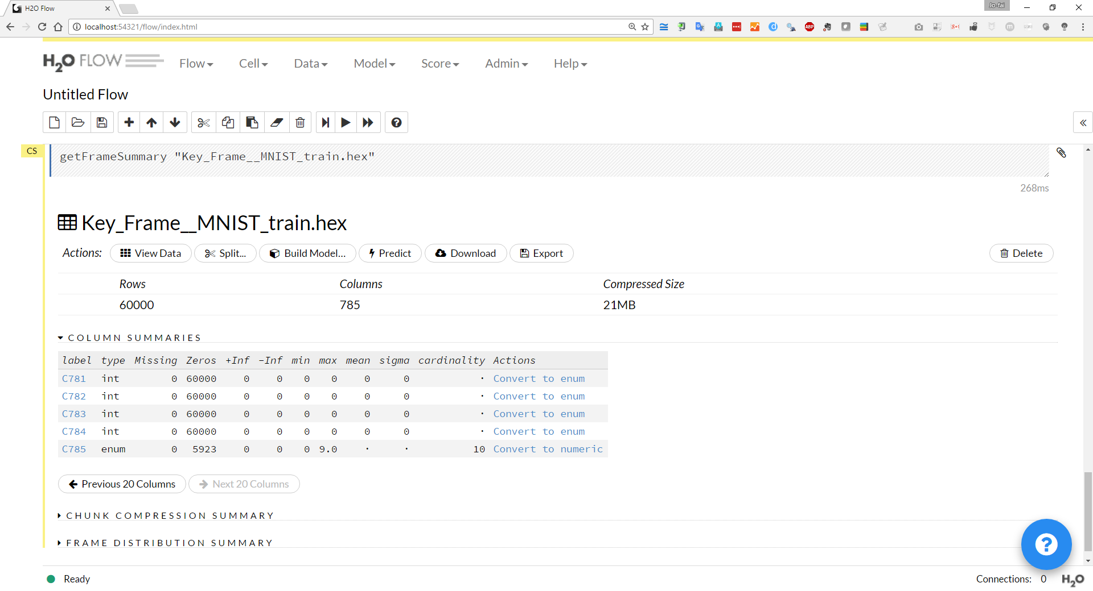
Note: Size in Memory
Click on individual labels to explore data

Slide 36
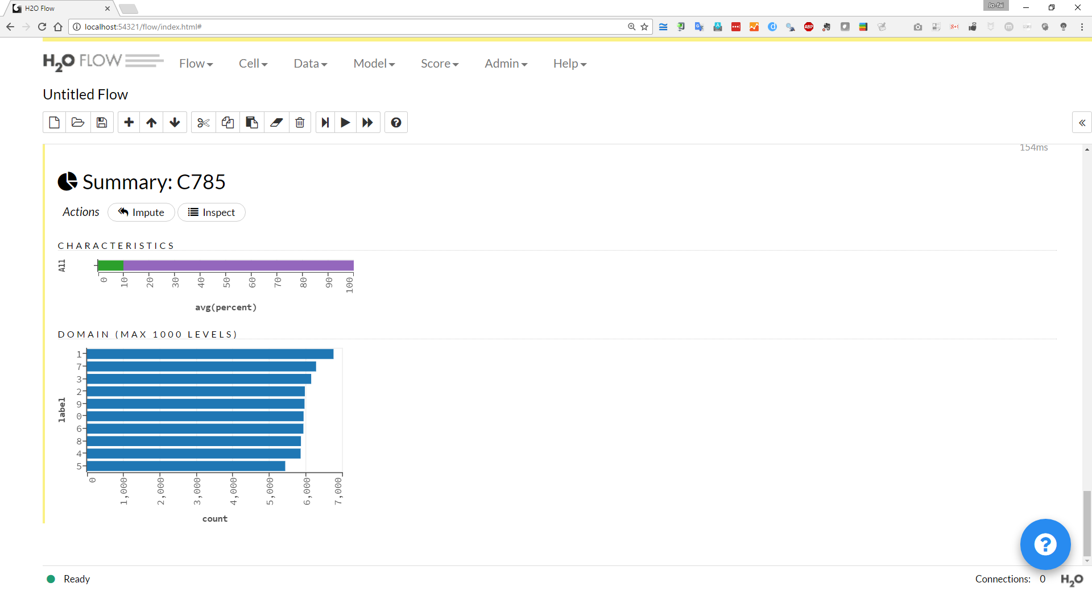

Slide 37
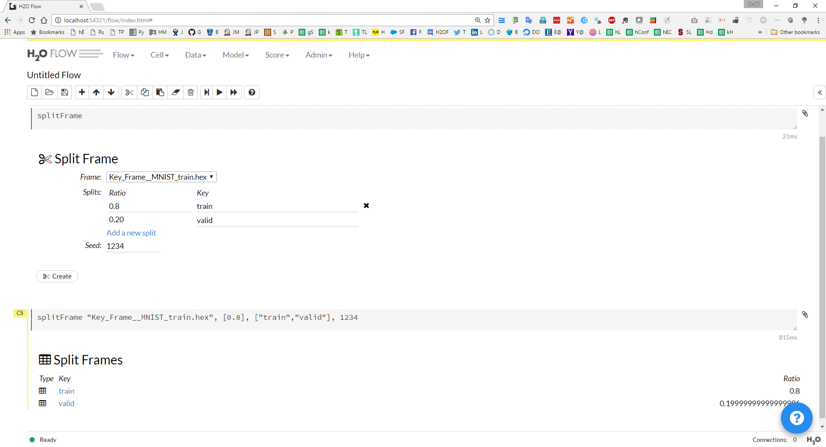
Split the full dataset into training (80% = 48k records) and validation (20% = 12k) – a common machine learning practice

Slide 38
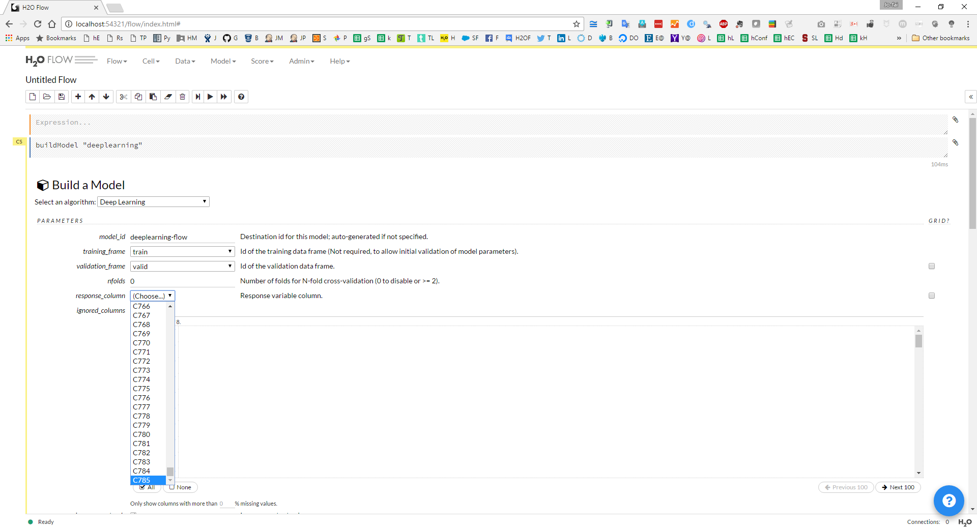
Click and select parameters
for model training

Slide 39
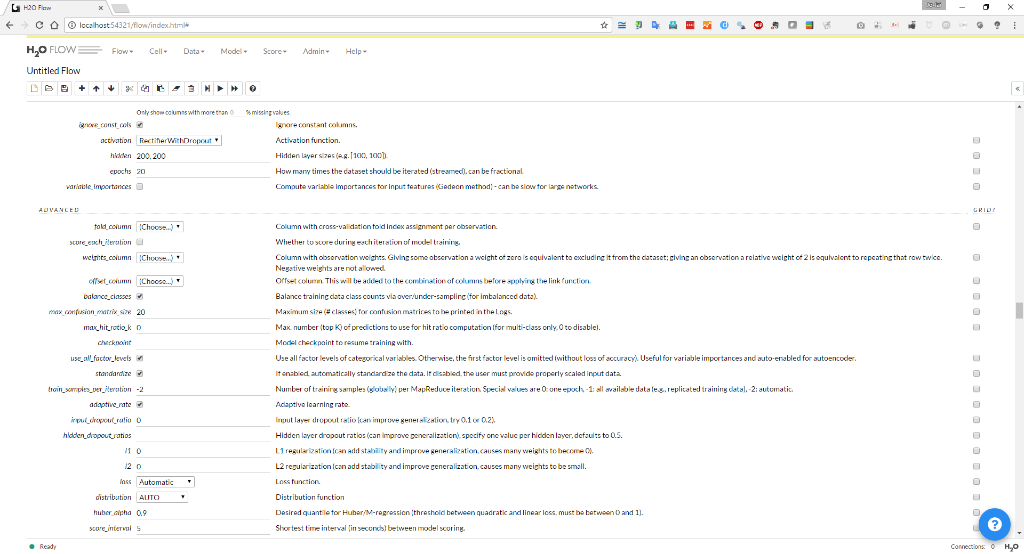
Users have full access to all available parameters – fine-tune model training process
For example, I am using
rectifier with dropout as the activation
to train the model for 20 epochs
with classes balancing
Leaving other settings as default

Slide 40
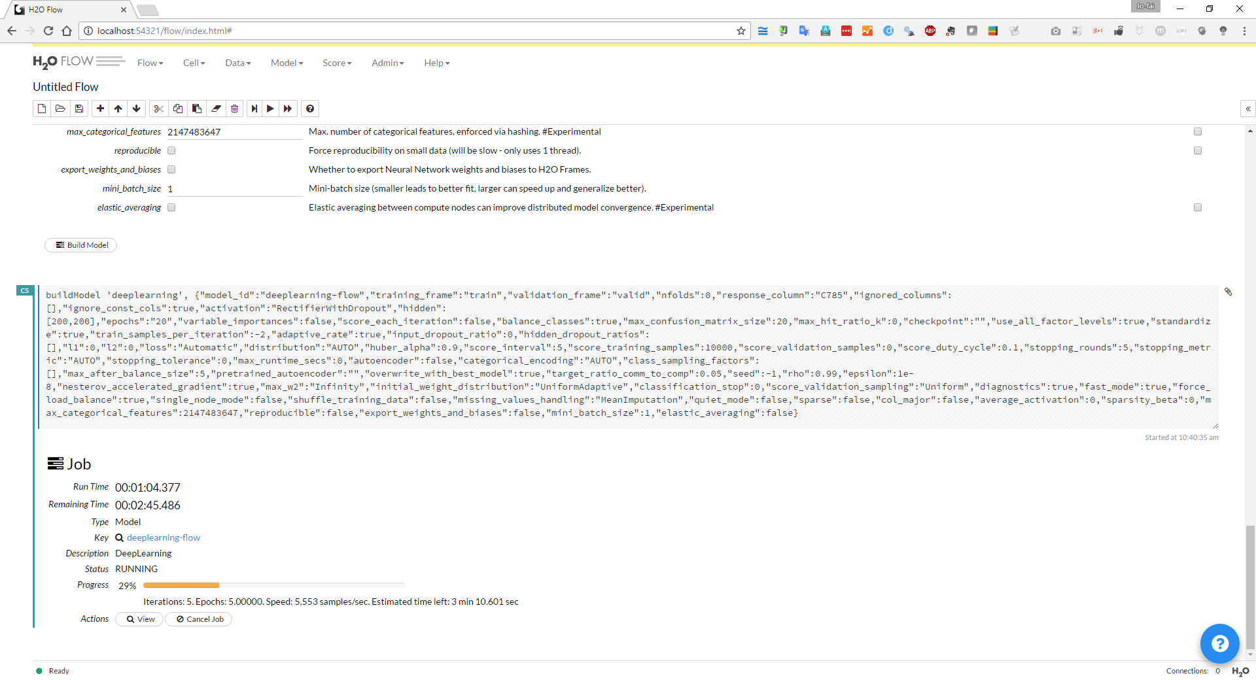
Training the model with estimated remaining time – users can stop the process early if they want to

Slide 41
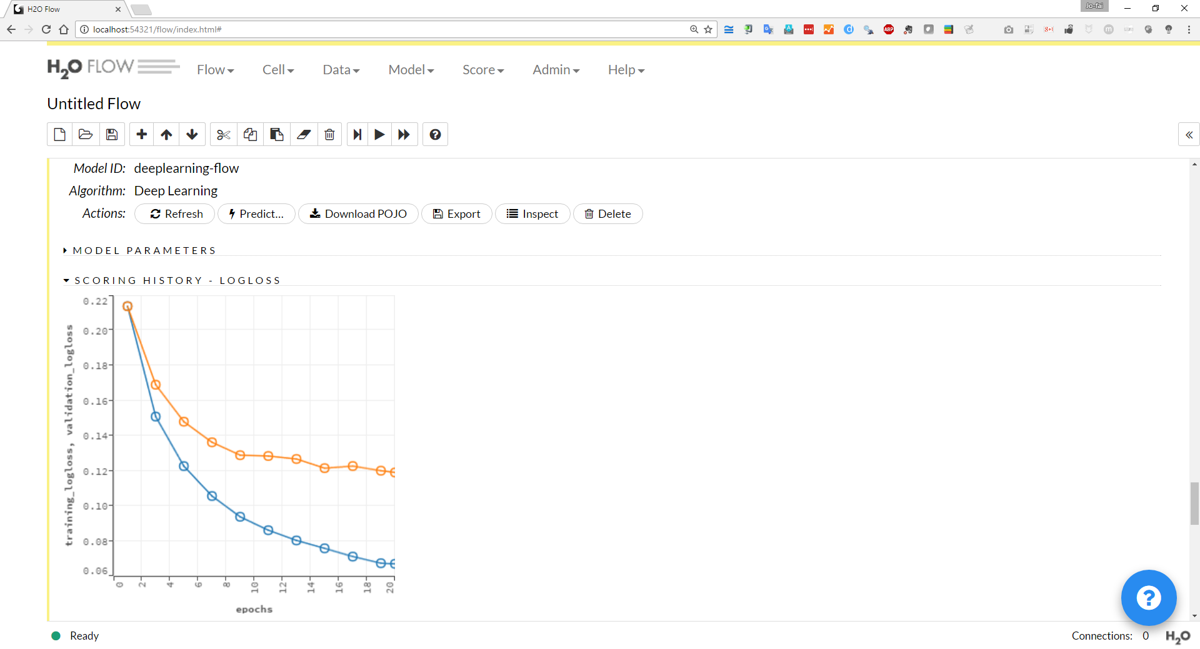
Performance (logloss) on validation set
Performance (logloss) on training set

Slide 42
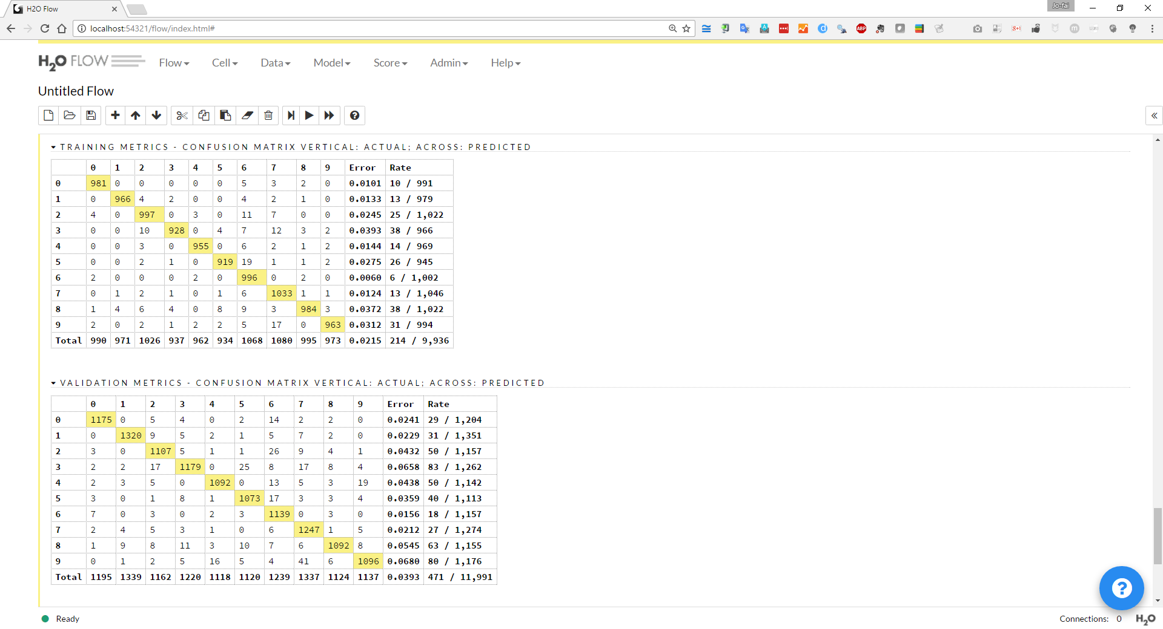
Confusion Matrix on Training Set (48k Records)
About 2% Error
Confusion Matrix on Validation Set (12k Records)
About 4% Error

Slide 43
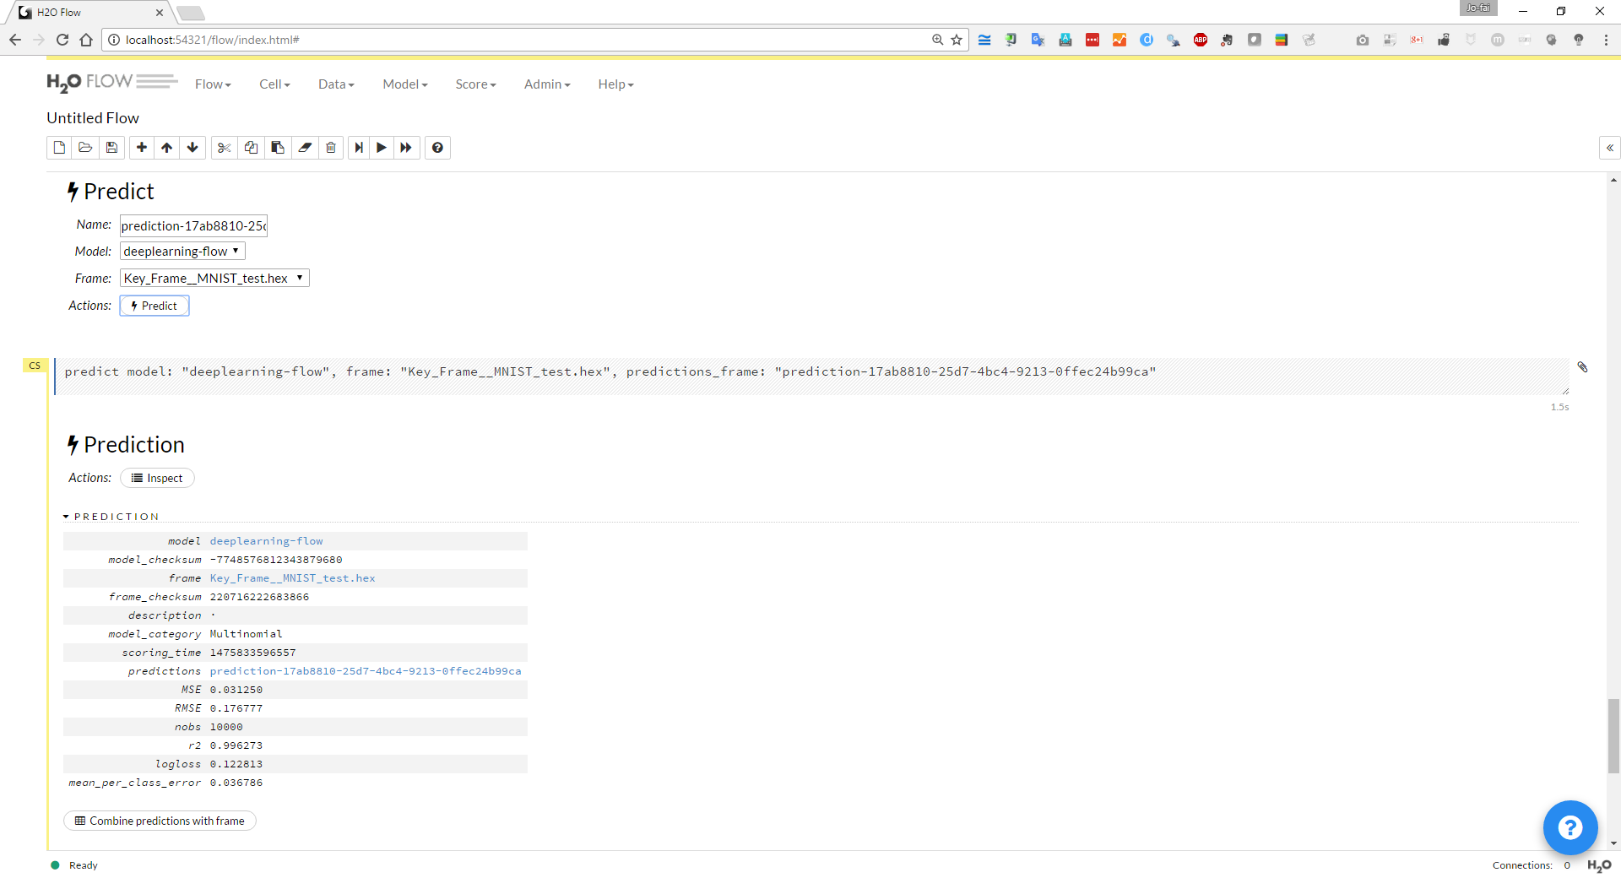
Using the model for prediction on test set

Slide 44
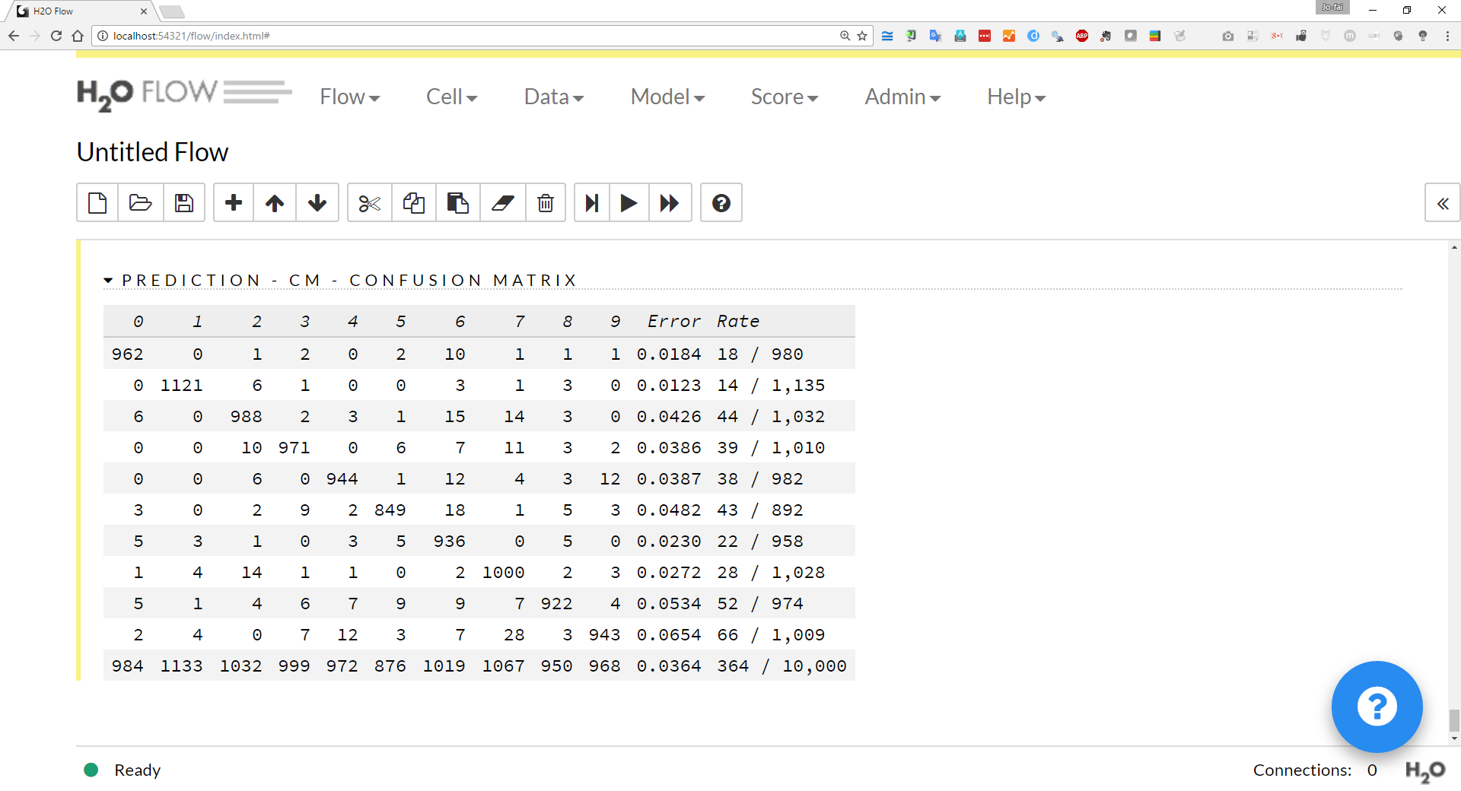
Confusion Matrix on Test Set (10k Records)
About 4% Error (similar to validation)

Slide 45
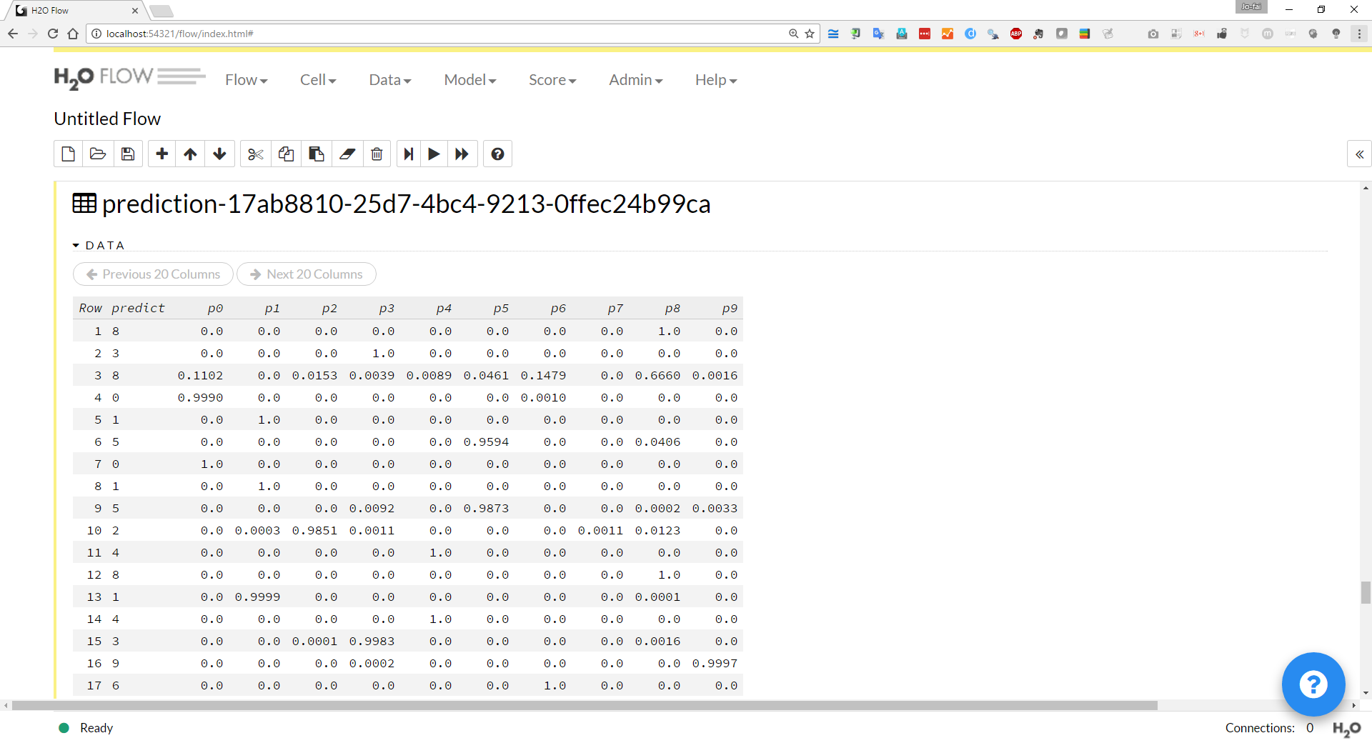
Full prediction outputs including individual probabilities and predicted label

Slide 46
